Slide 1
Australian Fatal Road Accident Data - 1989-2021
Group Members
Raymond Chau Joshua Lowe
Sam Walker Saleha Khatun

Slide 2
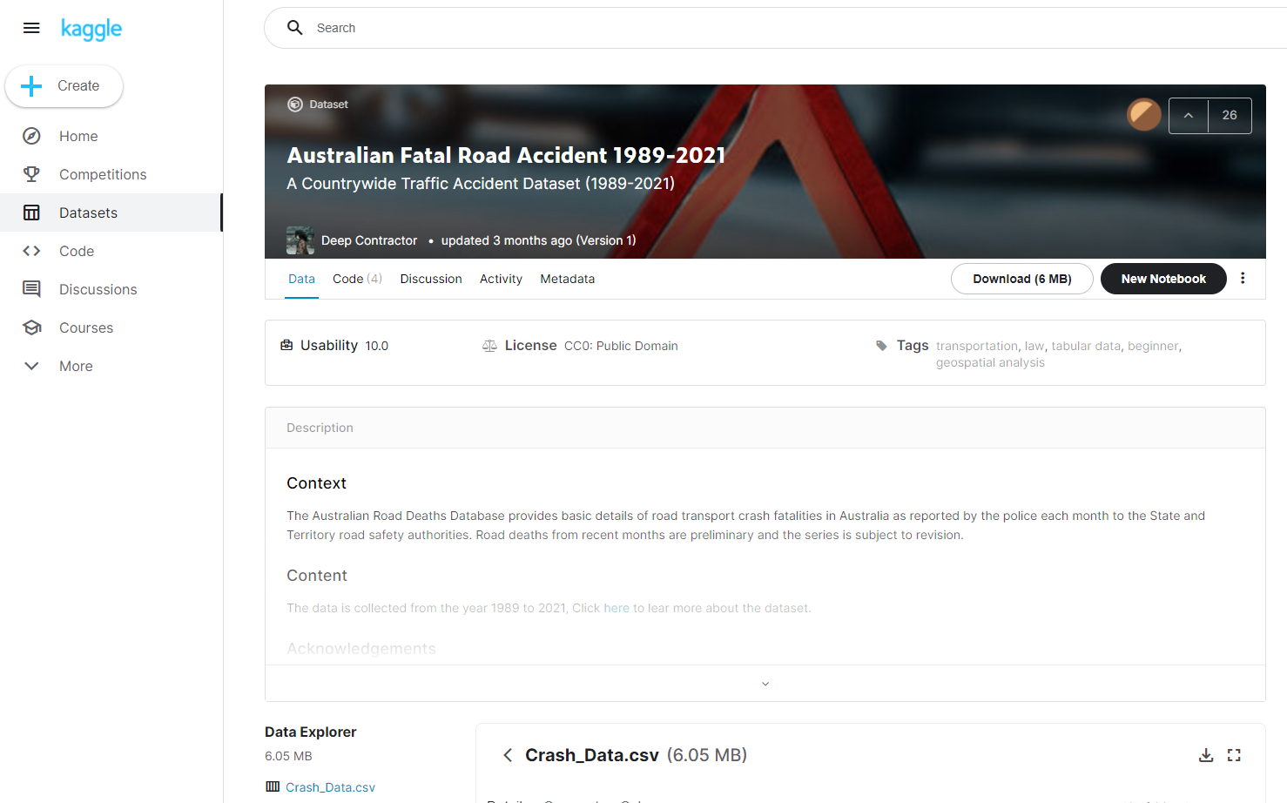
Key Dataset
Our key data set was comprised of many attributes of Fatal Road Accidents from the period between 1989 and 2021.
Information such as Driver Gender, Vehicle Type and Day of the Week were included, as well as many more.
One of the major limitations that we noticed is that the recorded data is particular for Fatal Accidents, so it can’t create a whole picture in the sense of minor bingles and fender benders, which could give a much clearer picture of the occurrence of all accidents.
https://www.kaggle.com/deepcontractor/australian-fatal-car-accident-data-19892021

Slide 3
Q1: What is the percentage of accident per State?
Q2: Which Day of the Week had more fatal accidents?
Saleha

Slide 4
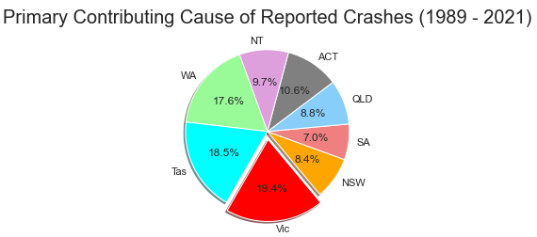
What is the percentage of accident per state?
We have used Car Crash data 1989-2021
Pie Chart to find the percentage accident each state. Which shows Vic has highest reported fatal accident 19.40%. The high fatality count would be due to a number of factors, but perhaps most likely because of road conditions, serious accidents happen more often on regional roads than metropolitan ones.
Plenty Road in Bundoora—not far from Melbourne’s CBD—is cited as Australia’s most dangerous road(reference-https://www.dinggo.com.au/blog/car-crash-statistics-australia) However, it’s also worth remembering these states vary in size, population & geographic measure.

Slide 5
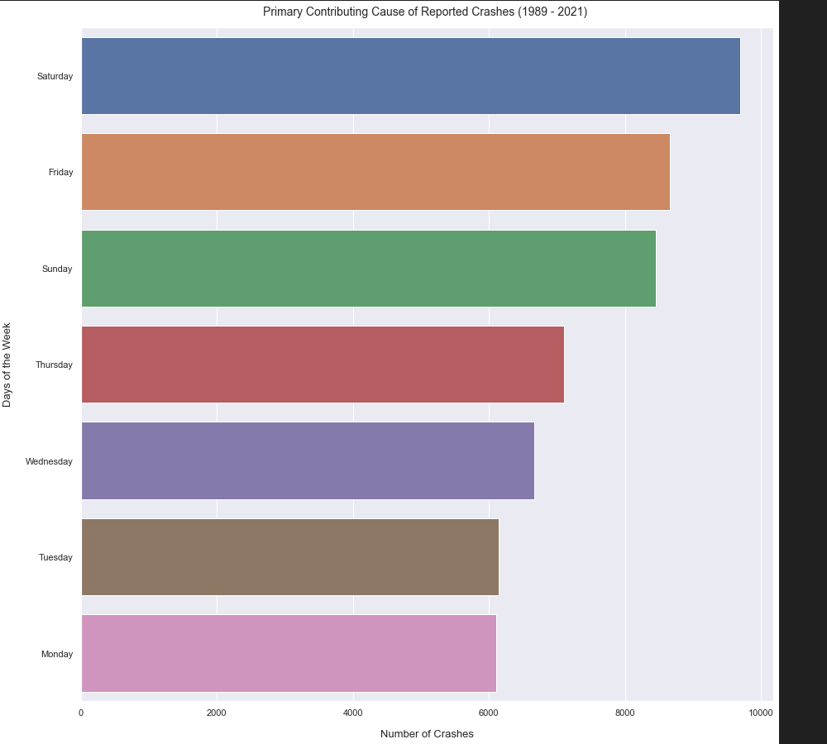
Which Day of the Week had more fatal accidents?
We have used Car Crash data 1989-2021
Used BarChart to find the Days of the week that highest accident reported. BarChart shows on a given week most road fatalities occur on Saturday. Common causes of accident are speeding, drink driving, fatigues driving and distracted driving
Saturday traffic is more social and higher risk for crash social driving more likely to involve alcohol. According to the study, more people are consuming alcohol on the weekends, and more people are also feeling relaxed after the work week. This leads to more drunk driving crashes, as well as speeding and other forms of reckless driving.(Reference: https://injurylawyer.com/accidents/study-says-most-auto-accidents-and-injuries-happen-on-saturday)

Slide 6
Q3:Fatal Accidents over the years
Q4: Fatal Accidents by Gender
Ray

Slide 7
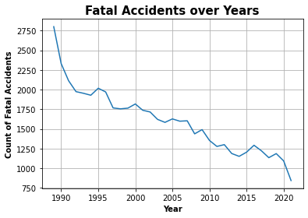
Are Fatal Car Accidents decreasing over the years?
What we did: We plotted a line chart to see the rate of fatal accidents over the years across the Australia.
What can we conclude: There’s a dramatic downtrend in fatal accidents in Australia. We looked into finding reasons why:
Car Safety Standards
Road regulations
Marketing & PR
From the information we have we can see there’s been a lot of advances in safety features and strict standards such as ANCAP which has contributed to reducing the number of fatal accidents over the year. Along with the regulations, policing and PR.

Slide 8
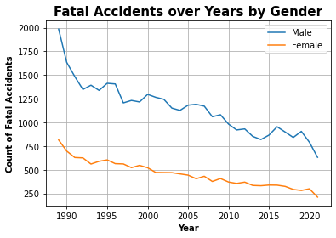
Fatal Accidents, which is the superior Gender?
We took a look to see the distribution of Male deaths vs Women. It appears that there are more Male drivers that end up dying. We dug a big bit deeper to find out why.
Notes:
https://www.carsguide.com.au/car-news/women-are-better-drivers-than-men-report-31199

Slide 9
Q5: Which types of road users are more likely to be involved in a fatal accident?
Sam

Slide 10
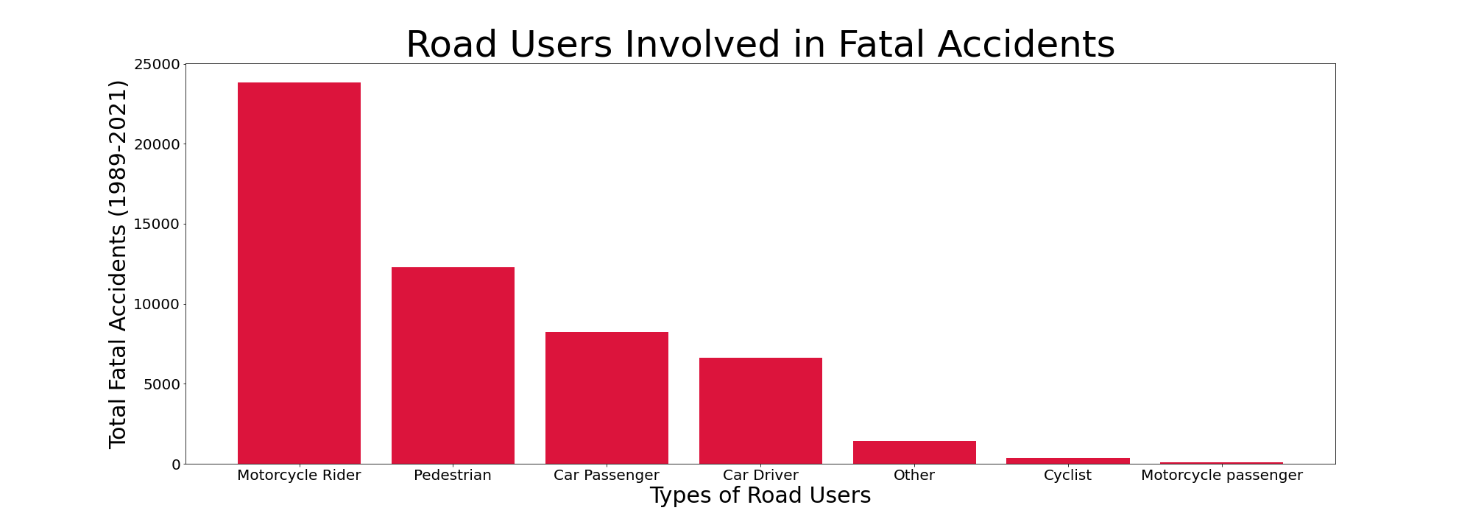
Which types of road users are more likely to be involved in a fatal accident?
The majority of road user type involved in fatal accidents is the motorcycle rider and in rare cases, a motorcycle passenger as well.
In attempting to improve motorcycle safety in Australia a number of initiatives have been implemented, including:
Increased understanding about the use of appropriate protective clothing and gear
Targeted safety campaigns and information sharing
Improved vehicle safety & technology such as anti-lock braking systems (ABS)
Additional motorcycle training and education, including a focus on defensive driving

Slide 11


Which types of road users are more likely to be involved in a fatal accident?
Almost everyone is a pedestrian at some point.
Pedestrian fatalities on the road are also quite significant and may occur in many circumstances, such as:
Crossing the road and being struck by a vehicle
Lack of dedicated infrastructure eg. facilities for pedestrians such as safe footpaths & crossings
Playing, working in or otherwise occupying a traffic or emergency lane
Carelessness of surroundings either from the pedestrian, vehicle user or both parties

Slide 12
Q6: Does rainfall contribute to a higher rate of fatal road accidents?
Josh

Slide 13
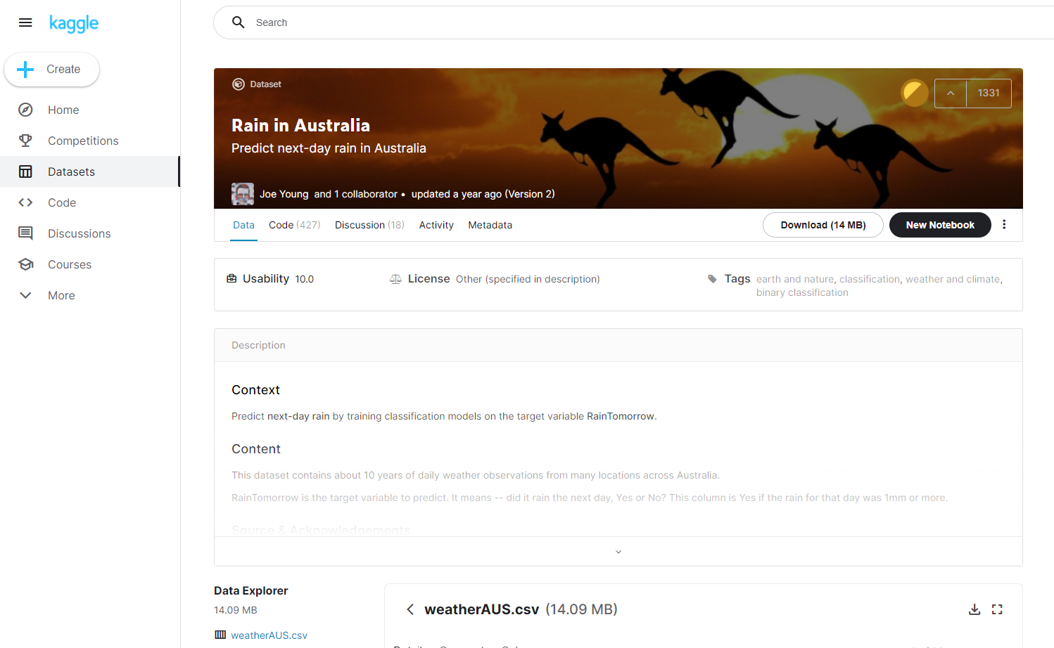
New Dataset
This data set was created by collecting daily data from BOM weather stations. The particular piece that we were interested in was the Rainfall, however, Humidity, Wind Speeds and more were available too
https://www.kaggle.com/jsphyg/weather-dataset-rattle-package

Slide 14
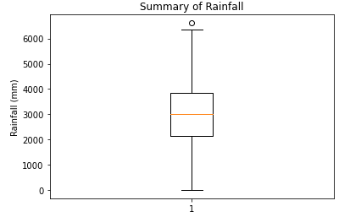
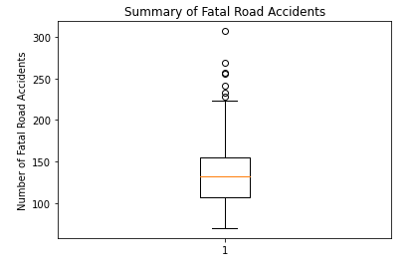
Does rainfall contribute to a higher rate of fatal road accidents?
Weather data from between 2007 and 2017 was sourced as to find rainfall specifically and was merged with our Fatal Road Accident data, based on the Month & Year of when both occurred.
Both data sets were checked for outliers using the 1.5*IQR rule and any points that fell outside the boundaries were dropped.

Slide 15
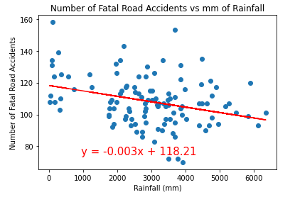
Does rainfall contribute to a higher rate of fatal road accidents?
The data was plotted into a scatter plot with Rainfall in mm as the x-axis and Number of Fatal Road Accidents as the y-axis.
With a correlation coefficient of -0.31, the results display a weak negative correlation between the Total Rainfall in the month and the Number of Fatal Road Accidents.
We can therefore concluded that the rate of fatal road accidents actually slightly decreases as rainfall increases.
This may be due to road users taking more care in wet conditions.

Slide 16
Sources
https://www.dinggo.com.au/blog/car-crash-statistics-australia
https://injurylawyer.com/accidents/study-says-most-auto-accidents-and-injuries-happen-on-saturday
https://rac.com.au/car-motoring/info/future_history-of-car-safety
https://www.emelbourne.net.au/biogs/EM00723b.htm
https://www.tac.vic.gov.au/road-safety/statistics/summaries/motorcycle-crash-data
https://www.tac.vic.gov.au/road-safety/statistics/summaries/pedestrian-statistics

Slide 17
Thanks for listening!

